Slide 1

Database

Slide 2
Select Statement
Select cols
From Table-Name
Where Condition
Order by cols

Slide 3
Data Retrieval
Doctors
id | fname | Lname | bdate | address | sal | Dno
1255 | Ahmad | sami | 9-May-1979 | Amman | 2000 | 20
1314 | Sara | ali | 1-jan-1996 | Irbid | 1550 | 20
1772 | Sana | khalil | 5-mar-1960 | Ajloun | 3000 | 1
5988 | mohammad | qais | 10-aug-1988 | Karak | 5700 | 5
3421 | leen | wesam | 10-feb-1987 | Amman | 2500 | 3

Slide 4
Basic Data Retrieval
Select * from doctors where sal=2000
Select * from doctors where fname=‘Sara’
id | fname | Lname | bdate | address | sal | Dno
1255 | Ahmad | sami | 9-May-1979 | Amman | 2000 | 20
id | fname | Lname | bdate | address | sal | Dno
1314 | Sara | ali | 1-jan-1996 | Irbid | 1550 | 20

Slide 5
Basic Data Retrieval
Select * from doctors where sal >= 3000
Select * from doctors where bdate> ‘1-jan-1986’
id | fname | Lname | bdate | address | sal | Dno
1772 | Sana | khalil | 5-mar-1960 | Ajloun | 3000 | 1
5988 | mohammad | qais | 10-aug-1988 | Karak | 5700 | 5
id | fname | Lname | bdate | address | sal | Dno
1314 | Sara | ali | 1-jan-1996 | Irbid | 1550 | 20
5988 | mohammad | qais | 10-aug-1988 | Karak | 5700 | 5
3421 | leen | wesam | 10-feb-1987 | Amman | 2500 | 3

Slide 6
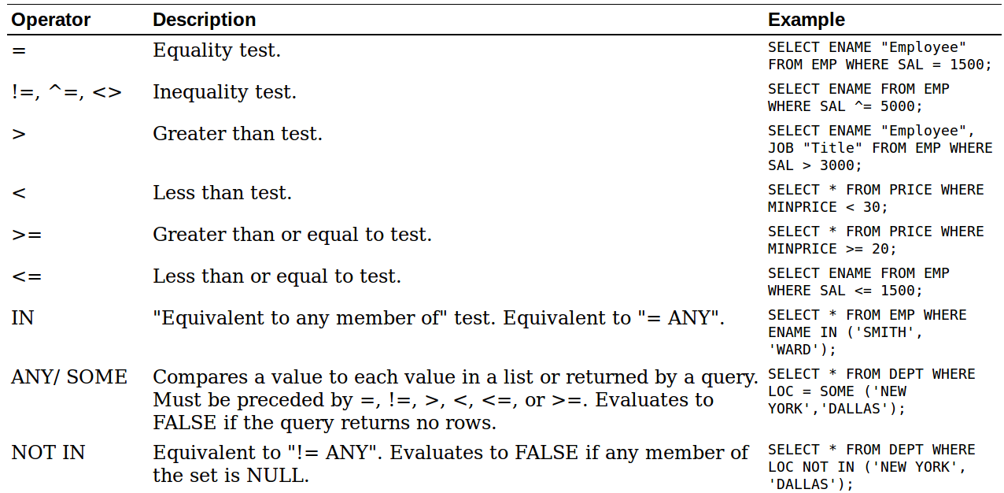
Basic Data Retrieval

Slide 7
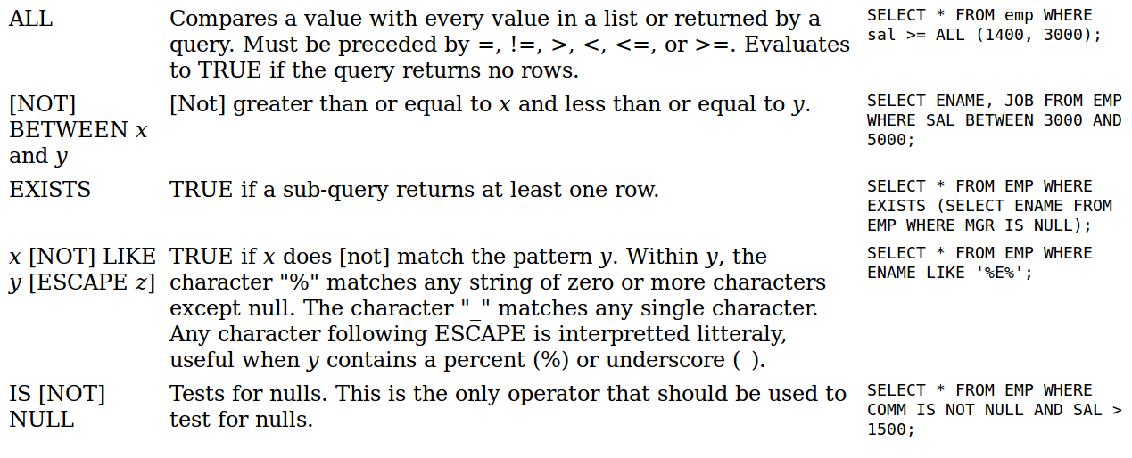
Basic Data Retrieval

Slide 8
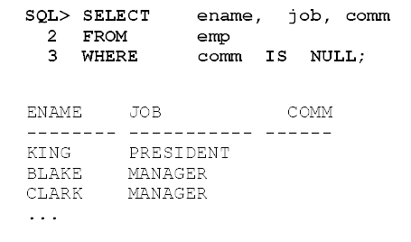
Null values-is Null/is not Null

Slide 9
Basic Data Retrieval
Select * from doctors where sal >= 3000 and Dno = 1
Select * from doctors where bdate> ‘1-jan-1986’ or Lname=‘khalil’
id | fname | Lname | bdate | address | sal | Dno
1772 | Sana | khalil | 5-mar-1960 | Ajloun | 3000 | 1
id | fname | Lname | bdate | address | sal | Dno
1314 | Sara | ali | 1-jan-1996 | Irbid | 1550 | 20
5988 | mohammad | qais | 10-aug-1988 | Karak | 5700 | 5
3421 | leen | wesam | 10-feb-1987 | Amman | 2500 | 3
1772 | Sana | khalil | 5-mar-1960 | Ajloun | 3000 | 1

Slide 10
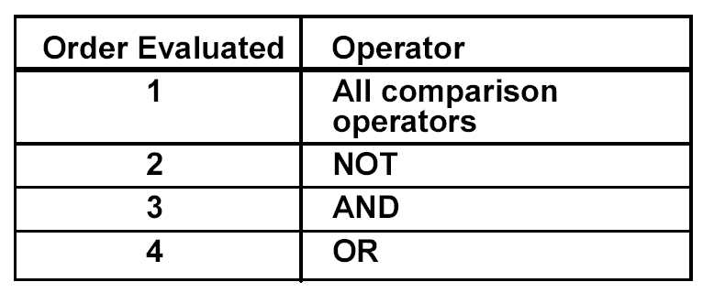
Operators

Slide 11
In/not in
Display the name, job, and salary for all employees whose job is Manager or ANALYST and their salary is not equal to $1000, $3000, $5000.

Slide 12
Basic Data Retrieval
Select * from doctors where lname like ‘_ _ali%’
Select * from doctors where bdate like ‘%1996’
id | fname | Lname | bdate | address | sal | Dno
1772 | Sana | khalil | 5-mar-1960 | Ajloun | 3000 | 1
id | fname | Lname | bdate | address | sal | Dno
1314 | Sara | ali | 1-jan-1996 | Irbid | 1550 | 20

Slide 13
Basic Data Retrieval
Select fname from doctors where lname like ‘_ _ali%’
Select id , address from doctors where bdate like ‘%1986’
fname
Sana
id | address
1314 | Irbid

Slide 14
Order by
Select * from doctors order by fname
Two choices :Asc ,Desc
Char / Number /Date
Two columns
Aliases
id | fname | Lname | bdate | address | sal | Dno
1255 | ahmad | sami | 9-May-1979 | Amman | 2000 | 20
3421 | leen | wesam | 10-feb-1987 | Amman | 2500 | 3
5988 | mohammad | qais | 10-aug-1988 | Karak | 5700 | 5
1772 | sana | khalil | 5-mar-1960 | Ajloun | 3000 | 1
1314 | sara | ali | 1-jan-1996 | Irbid | 1550 | 20

Slide 15
Order by
Select * from doctors order by fname desc
id | fname | Lname | bdate | address | sal | Dno
1314 | sara | ali | 1-jan-1996 | Irbid | 1550 | 20
1772 | sana | khalil | 5-mar-1960 | Ajloun | 3000 | 1
5988 | mohammad | qais | 10-aug-1988 | Karak | 5700 | 5
3421 | leen | wesam | 10-feb-1987 | Amman | 2500 | 3
1255 | ahmad | sami | 9-May-1979 | Amman | 2000 | 20

Slide 16
Order by/alias
Select fname, sal*12 from
doctors order by sal*12
Select fname, sal*12 as “The salary” from doctors order by “The salary”
fname | Sal*12
Sara | 18600
Ahmad | 24000
leen | 30000
Sana | 36000
mohammad | 68400
fname | salary
Sara | 18600
Ahmad | 24000
leen | 30000
Sana | 36000
mohammad | 68400

Slide 17
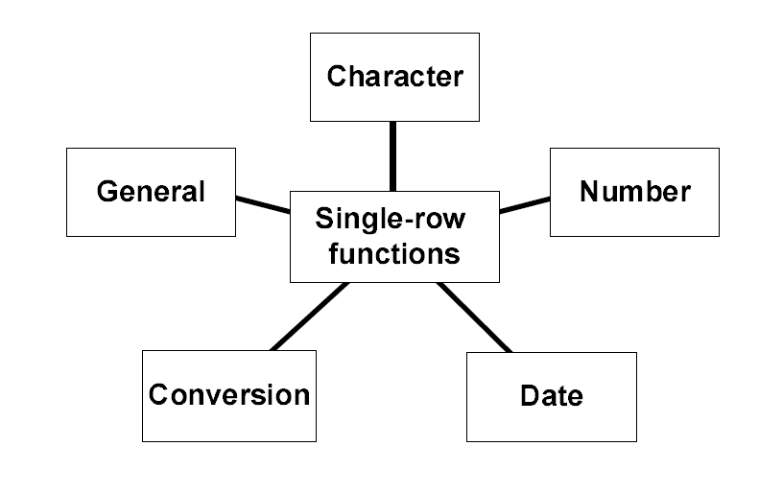
Single row functions

Slide 18
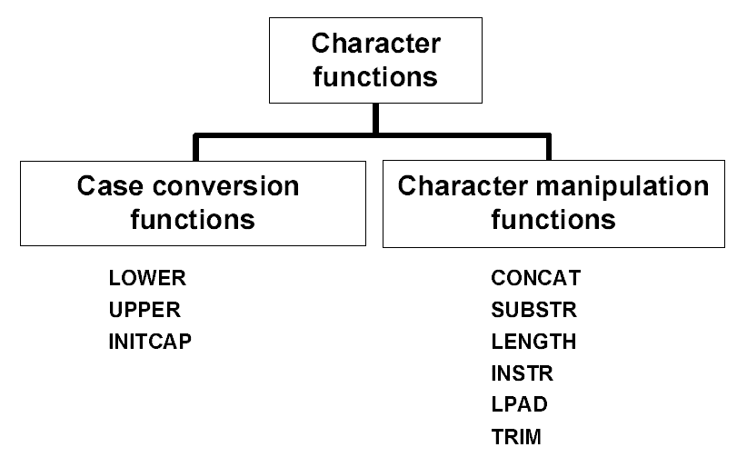
Character

Slide 19
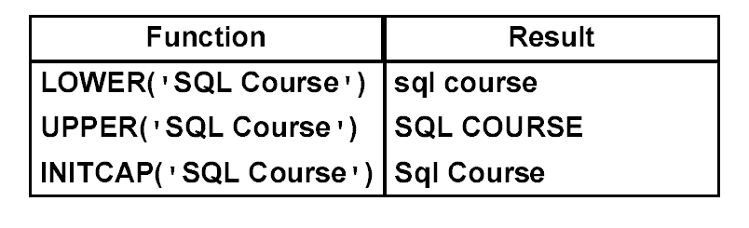
Case conversion functions

Slide 20
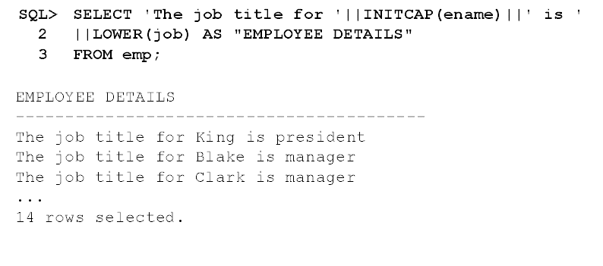
Example 1

Slide 21
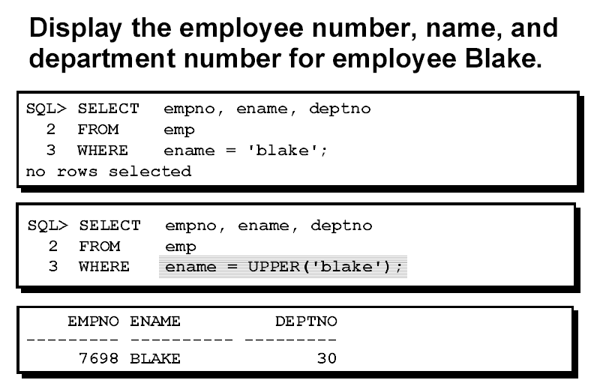
Example 2

Slide 22
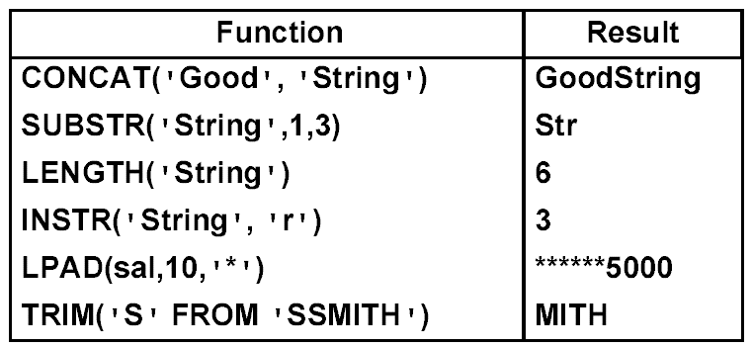
Character manipulation functions

Slide 23
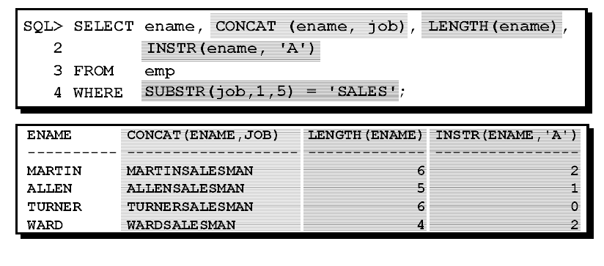
Example

Slide 24
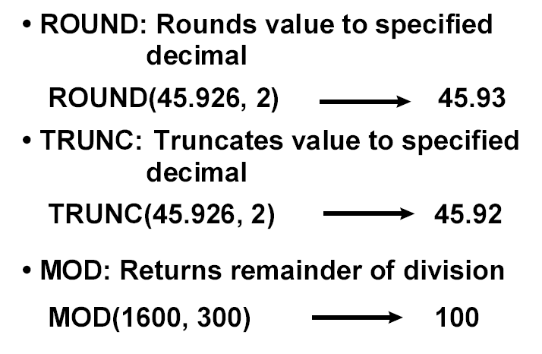
Number Functions

Slide 25
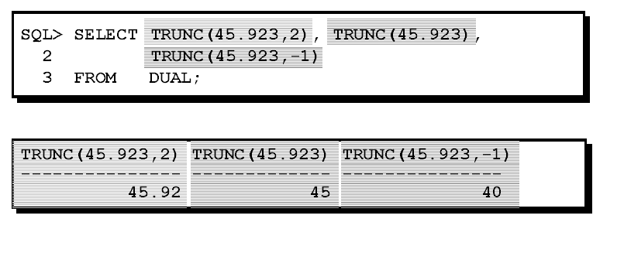
Example

